Slide 1


Intermediate Python
Class Coding Details

Slide 2
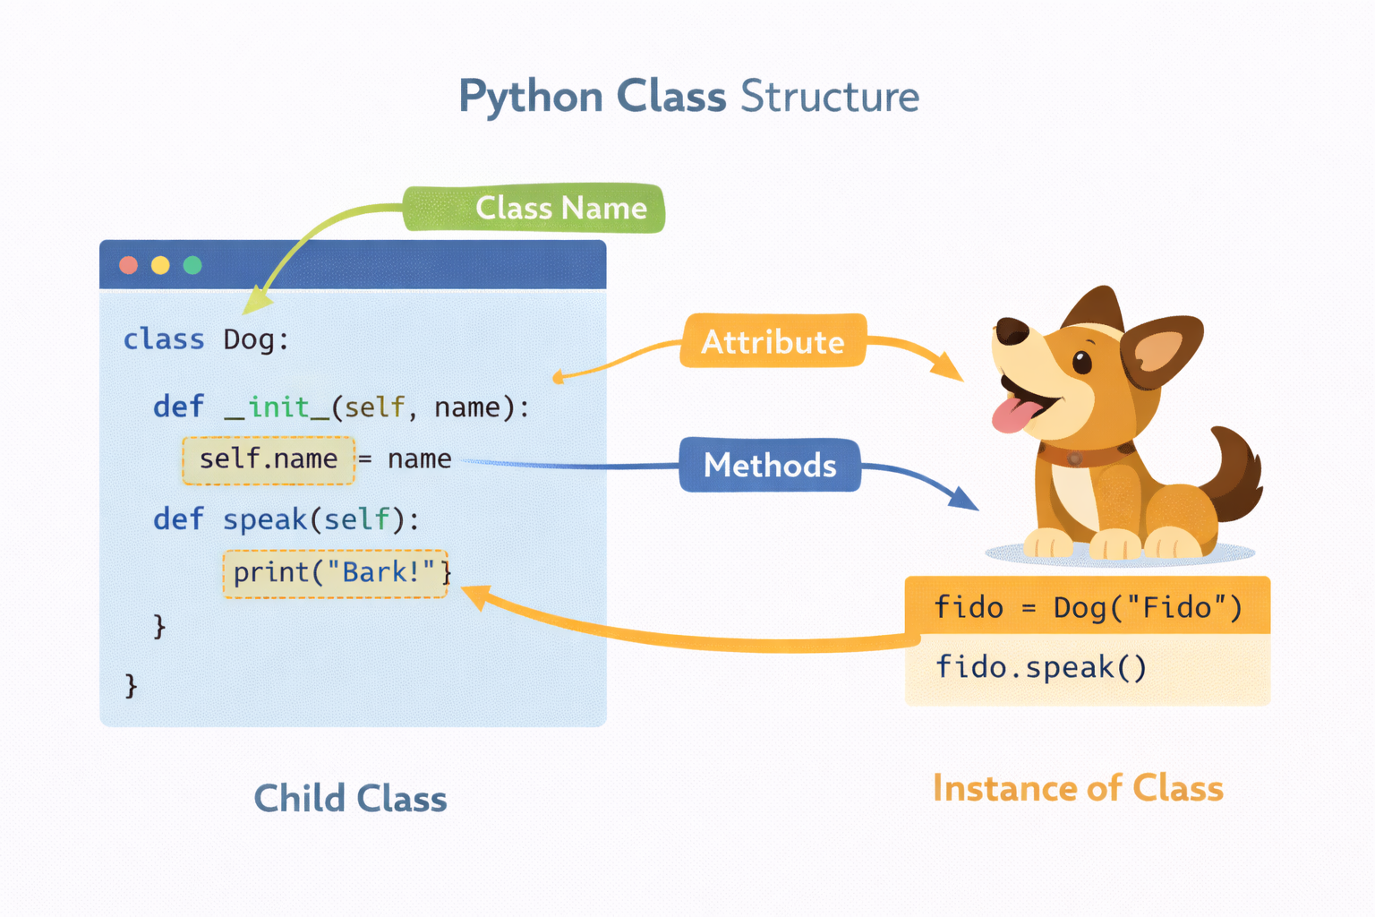
class Statement Anatomy
The class statement defines structure, behavior, and identity of objects.
class creates a new type
Class body executes immediately
Methods are functions inside a class
self refers to the instance
Attributes belong to instance or class
Slide 5 —
Suggested 2-Hour Teaching Flow
25 min — Class Anatomy
25 min — super() and inheritance internals
30 min — Abstract Base Classes
20 min — Namespaces & LEGB
20 min — Docstrings & documentation
10 min — Review + Q&A
Session 4 Key Takeaways
Classes are executable blocks
super() enables safe extension
ABCs enforce design contracts
LEGB controls name resolution
Docstrings are first-class documentation
Notes:
Emphasize that the class body runs at definition time. Clarify difference between class attributes and instance attributes. Reinforce self is explicit in Python by design.

Slide 3
Example Python Code
class User:
role = "guest" # class attribute
def __init__(self, name):
self.name = name # instance attribute
def greet(self):
return f"Hello {self.name}"

Slide 4
super() Usage
super() lets a subclass reuse and extend parent class behavior.
Calls parent class methods
Avoids code duplication
Essential in inheritance chains
Supports cooperative multiple inheritance
Improves maintainability
Notes:
Explain why calling parent initializers is critical. Mention that super() follows MRO, not just “parent”. Avoid manually calling parent class names.

Slide 5
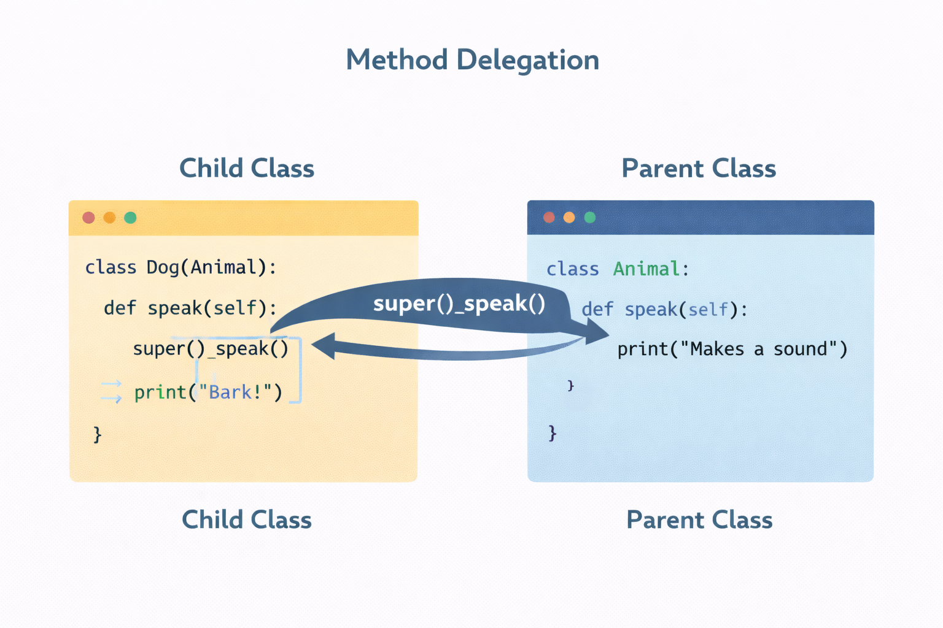

Slide 6
Example Python code
class Person:
def __init__(self, name):
self.name = name
class Employee(Person):
def __init__(self, name, emp_id):
super().__init__(name)
self.emp_id = emp_id

Slide 7
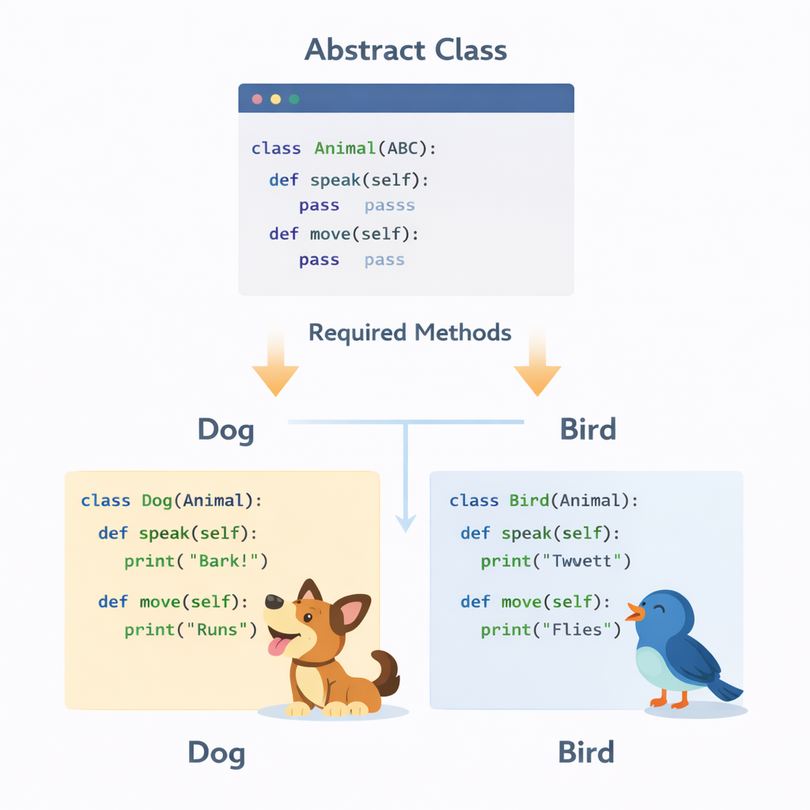
Abstract Base Classes (ABC)
Abstract Base Classes define required methods without implementations.
Enforce method contracts
Prevent incomplete implementations
Defined using abc module
Abstract methods must be overridden
Useful for frameworks and APIs
Notes:
Explain “contract before implementation”. Show what happens if abstract methods aren’t implemented. Relate to real-world interfaces (payment, storage, logging).

Slide 8
Example Python Code
from abc import ABC, abstractmethod
class Payment(ABC):
@abstractmethod
def pay(self, amount):
pass
class CardPayment(Payment):
def pay(self, amount):
print(f"Paying {amount} by card")

Slide 9
Docstrings & Documentation
Docstrings make your classes self-documenting.
Describe purpose and behavior
Accessible via help() and __doc__
Used by documentation tools
Improve readability and maintenance
Essential for shared codebases
Notes:
Emphasize docstrings are not comments. Show how tools extract documentation automatically. Encourage writing docstrings from day one.

Slide 10
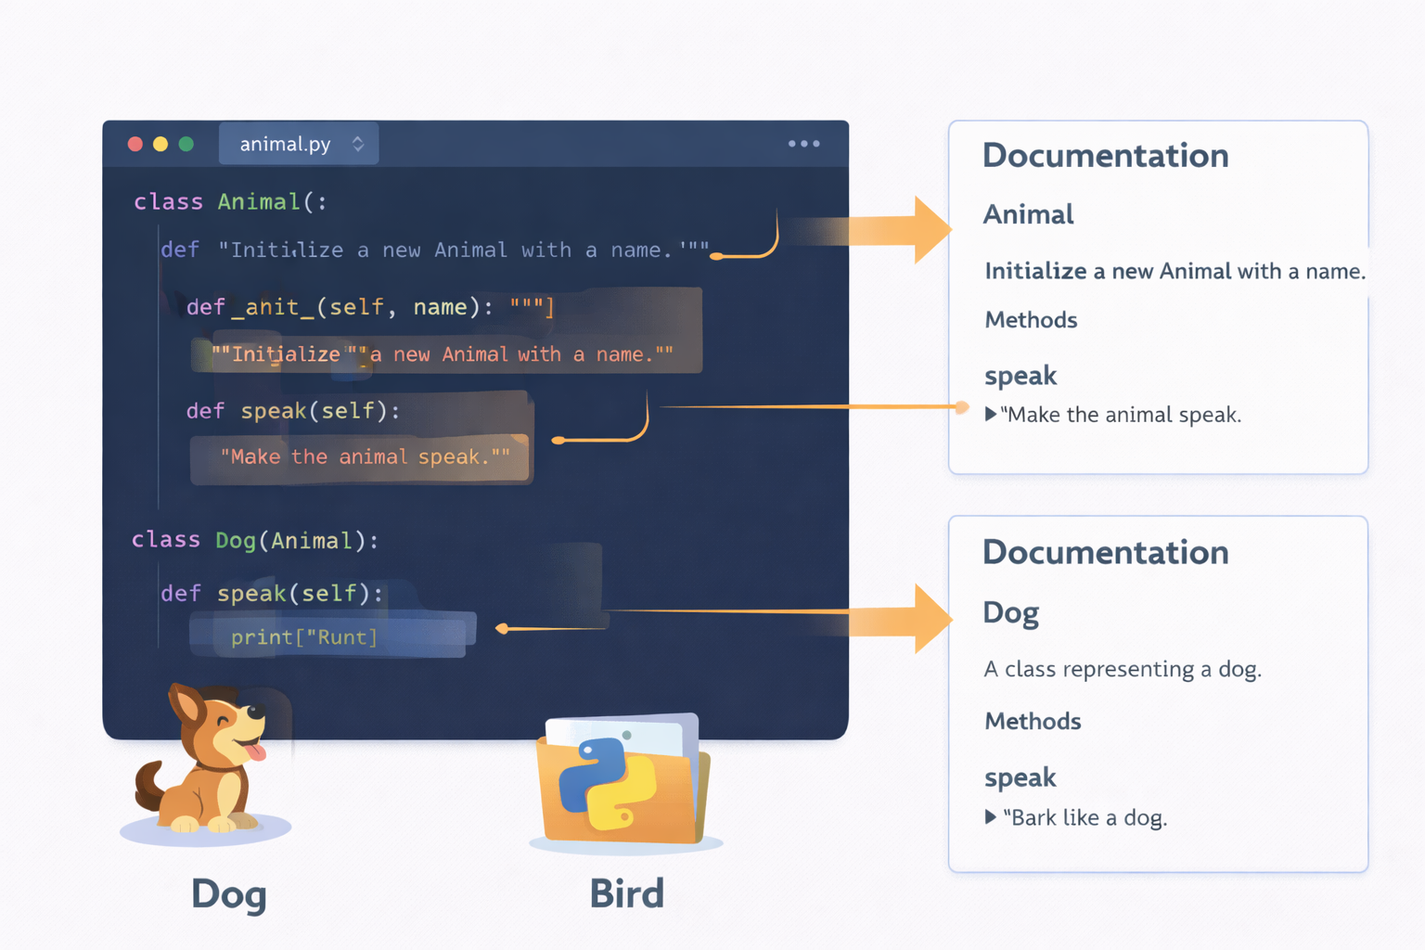

Slide 11
Example Python Code
class Calculator:
"""Performs basic arithmetic operations."""
def add(self, a, b):
"""Return the sum of two numbers."""
return a + b
help(Calculator)

Slide 12
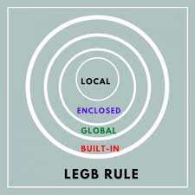
Namespaces & LEGB Rule
Python resolves names using the LEGB lookup rule.
Local → Enclosing → Global → Built-in
Classes introduce their own namespace
Methods use instance namespace first
Avoid name shadowing
Critical for debugging scope issues
Notes:
Walk through the lookup order step by step. Explain common bugs caused by shadowing variables. Connect LEGB to attribute lookup learned earlier.

Slide 13
Example Python Code
x = "global"
class Demo:
x = "class"
def show(self):
x = "local"
print(x)
d = Demo()
d.show()

